Slide 1
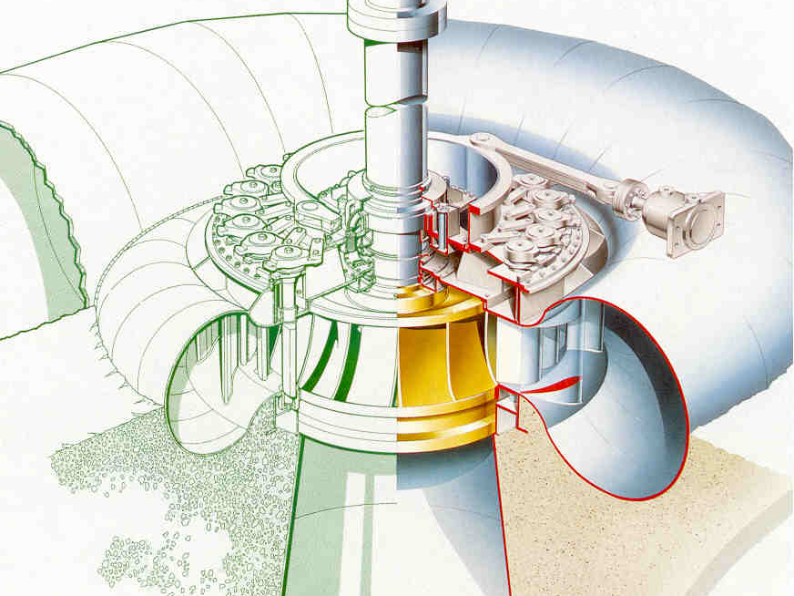
Francis turbines

Slide 2
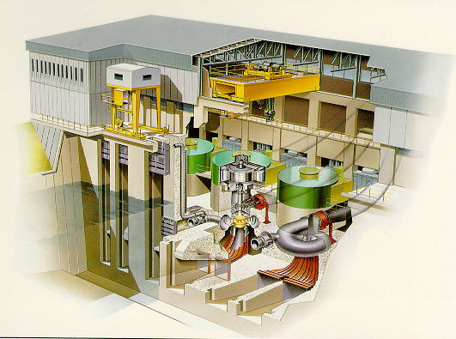

Slide 3
2. Different Parts:
Penstock:
It is a large sized conduct which conveys water from the upstream of the dam / reservoir to the T runner.
Spiral / scroll casing:
It constitutes a closed passage whose X-section area gradually decreases along the flow direction, area is maximum at inlet and nearly zero at exit.

Slide 4
2. Different Parts:
Guide vanes / wicket gates:
These vanes direct the water into the runner at an angle appropriate to design. It is operate by hand wheel or automatically.
Governing mechanism:
It changes the position of GV to affect the variation in water flow rate, when the load conditions on the T change.

Slide 5
2. Different Parts:
Runner and runner blades:
The driving force in the runner is both impulse and reaction.
Runner blade no. = 16 ~ 24.
Draft tube:
It is gradually expanding tube which helps easy discharges water, passing through runner to the tail race. Thus it helps to reuse of the exit water.

Slide 6
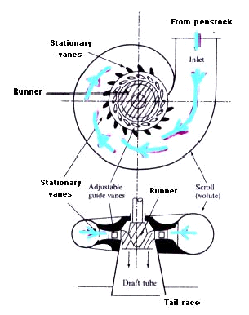
Parts of A Francis Turbine

Slide 7
Runner inlet (Φ 0.870m)
Guide vane outlet for designα) (Φ 0.913m)
Closed
Position
Max. Opening Position

Slide 8
Operation of Guide Vanes
.

Slide 9
Water particle
Water from spiral casing

Slide 10
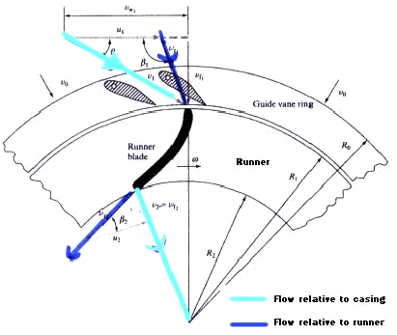
Parts of A Francis Turbine

Slide 11
Ideal Hydraulic Energy Diagram
Outlet
draft tube
Outlet
runner
Inlet
runner
Outlet
guide vane
Inlet
guide vane
h_{atm}

Slide 12
Hydraulic efficiency of Francis Hydraulic System

Slide 13
Friction losses
Friction losses in
the spiral casing
and stay vanes
Guide vane losses
Gap losses
Runner losses
Draft tube losses

Slide 14
Losses in Francis Turbines
Draft tube
Hydraulic Efficiency [%]
Output Energy
Head [m]

Slide 15
Losses in Francis Turbines
Hydraulic Efficiency [%]
Output Energy
Output [%]

Slide 16
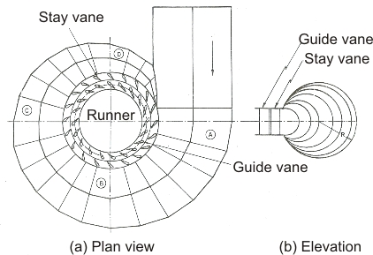
Spiral Casing
Spiral Casing : The fluid enters from the penstock to a spiral casing which completely surrounds the runner.
This casing is known as scroll casing or volute.
The cross-sectional area of this casing decreases uniformly along the circumference to keep the fluid velocity constant in magnitude along its path towards the stay vane/guide vane.

Slide 17
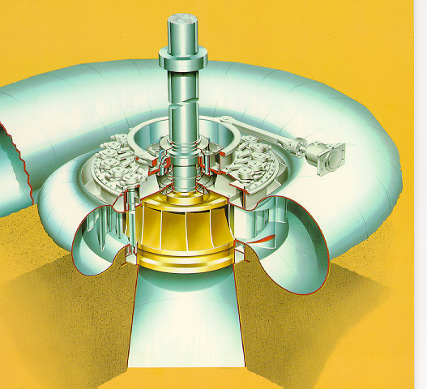

Slide 18
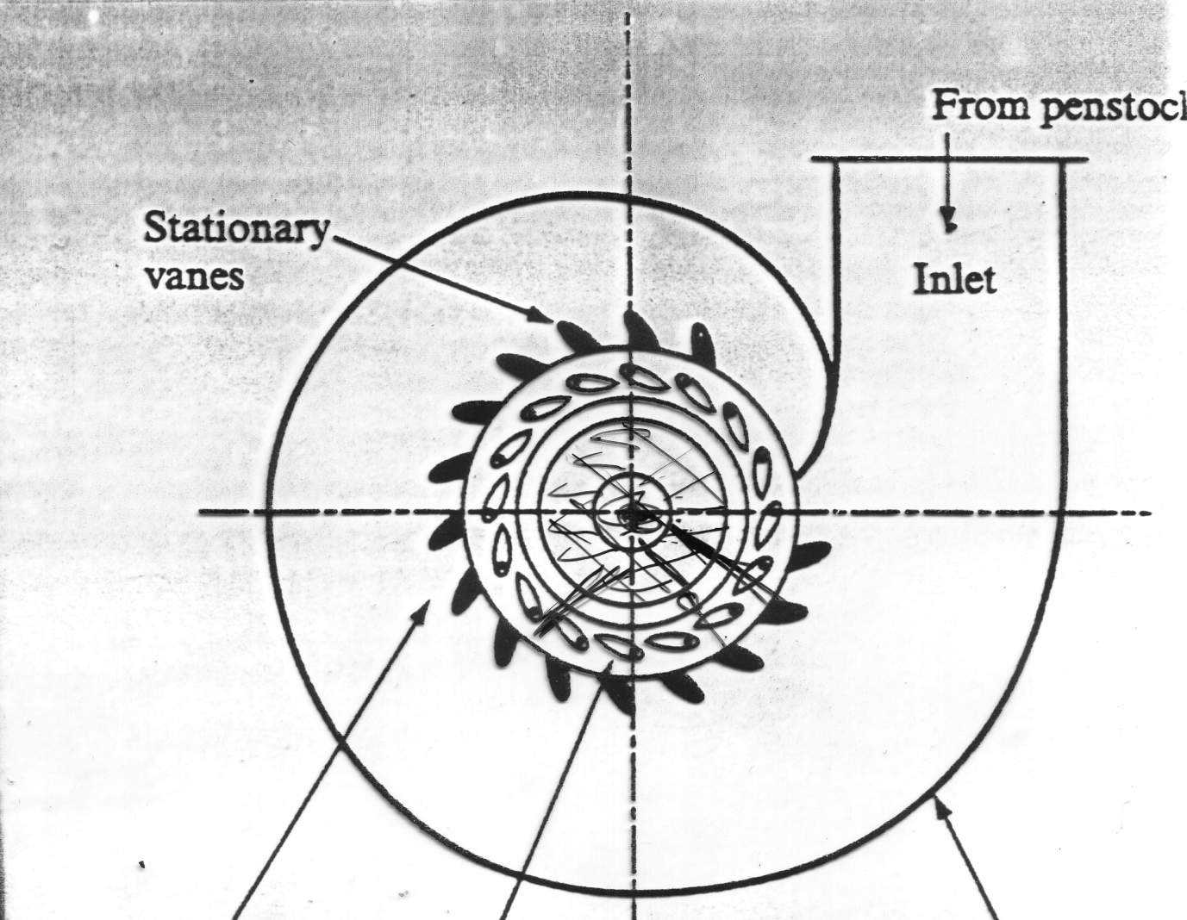
3. Construction (different Parts):

Slide 19
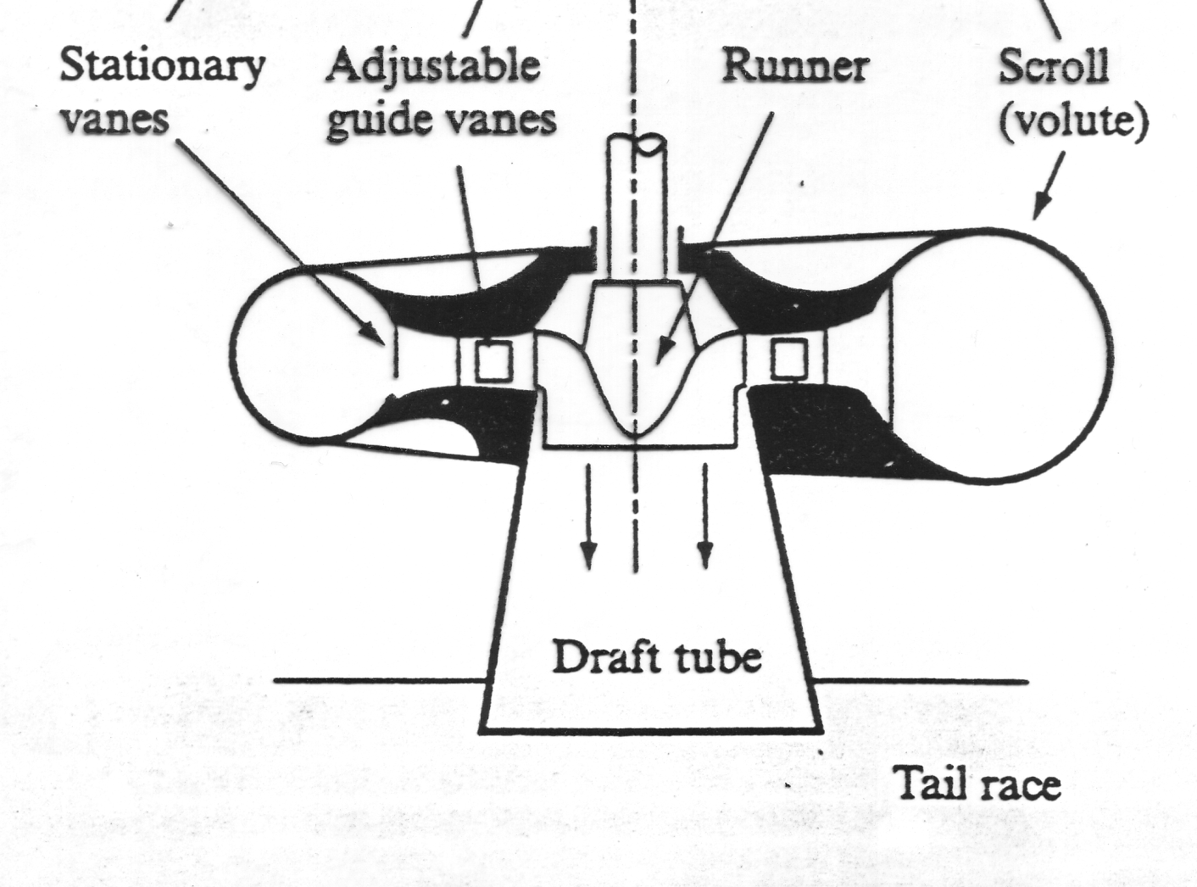
3. Construction (different Parts):

Slide 20
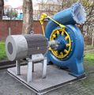
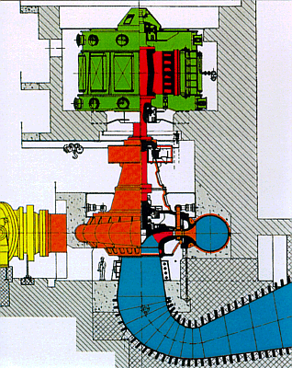
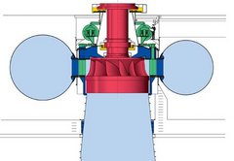

Slide 21
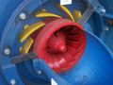
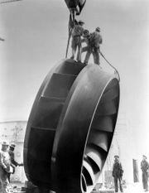
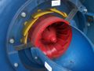

Slide 22
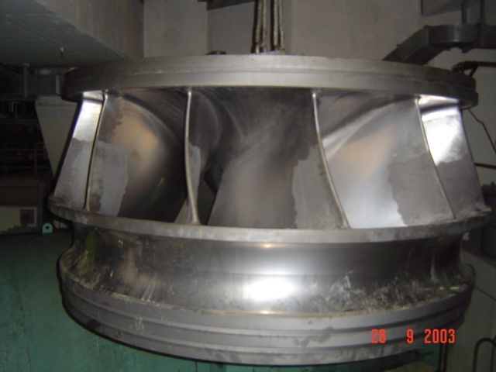

Slide 23
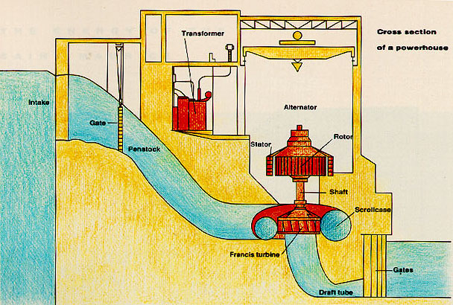

Slide 24
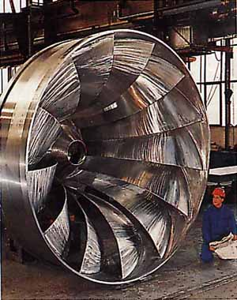
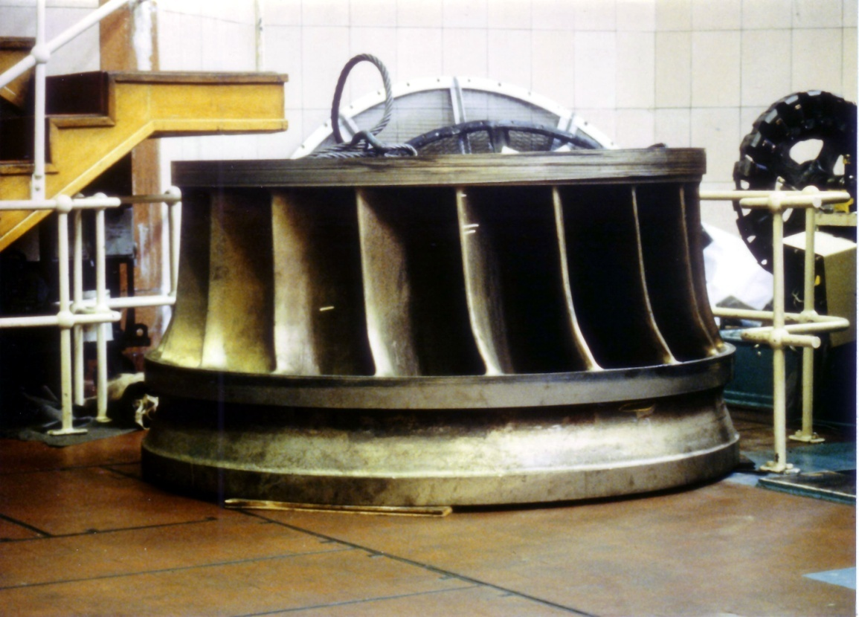

Slide 25
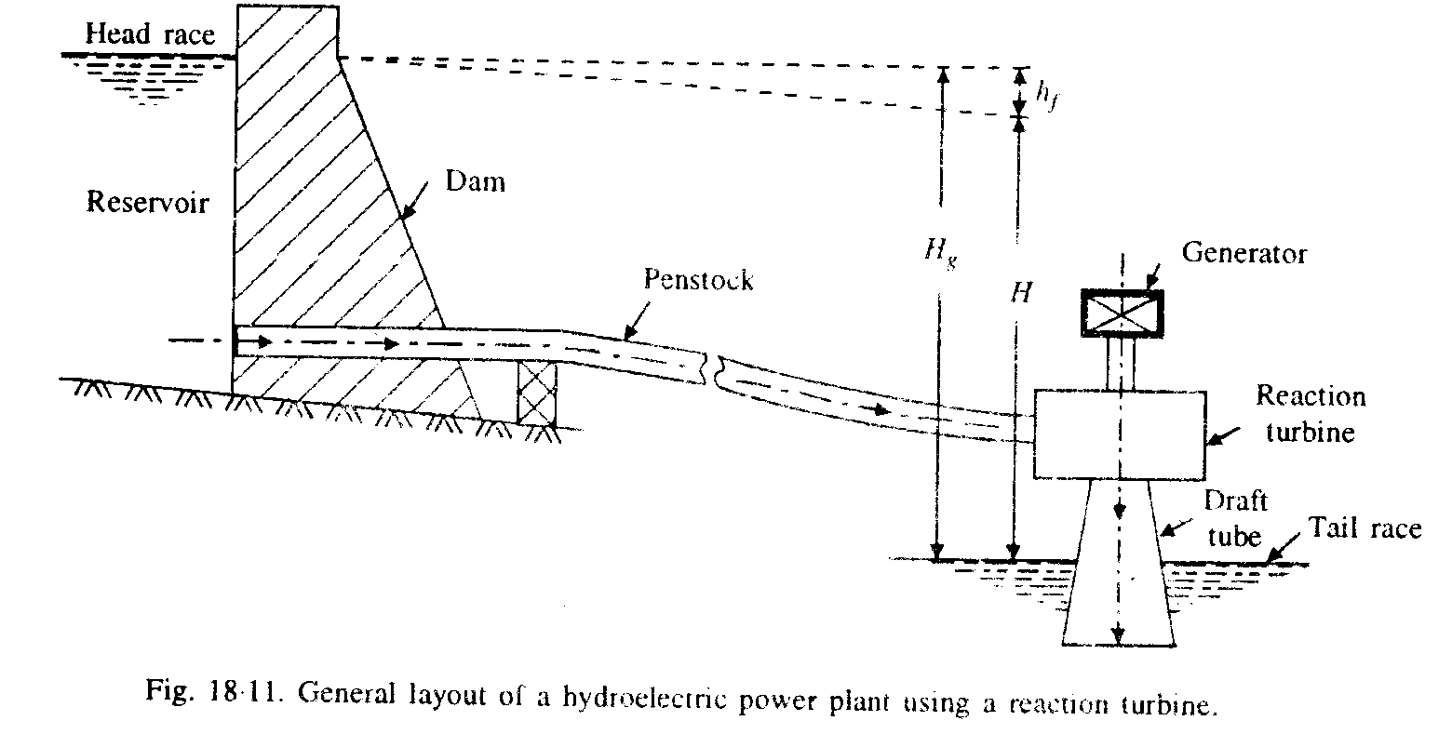
3. Construction (different Parts):

Slide 26
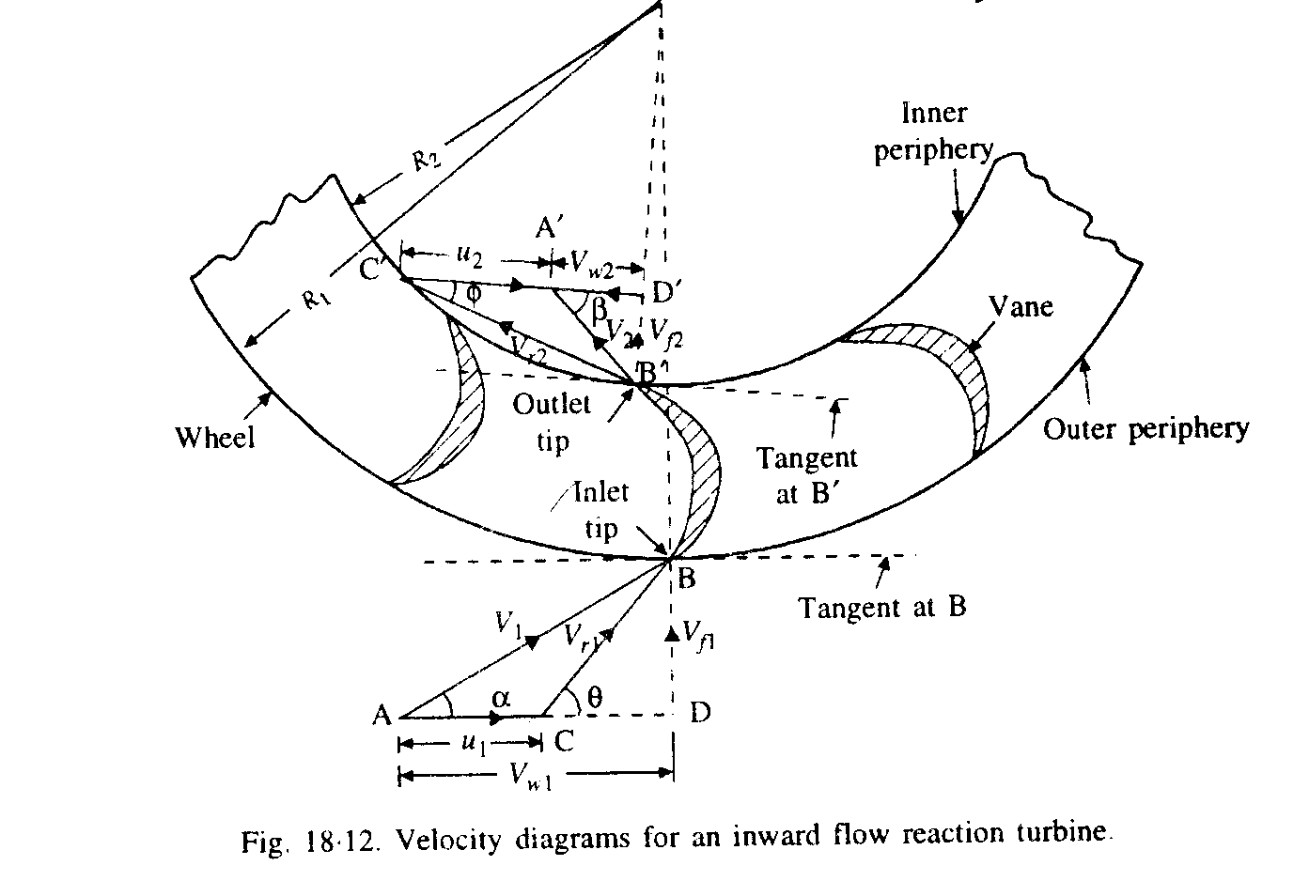
3. Construction (different Parts):

Slide 27
4. Working:
Water under pressure (from reservoir and penstock) enters the runner from the G/Vs towards the center in radial direction and discharges out of the runner axially.
Energy of water transfer to rotational energy of runner then rotation of shaft.
There is a difference of pressure between the G/Vs and the runner which is called reaction pressure and is responsible for the motion of the runner.

Slide 28
4. Working:
The pressure at inlet is more than outlet.
Water flow through the spiral casing.
Water release from a draft tube submersed in water for easy release and reuse of exit water.

Slide 29
Calculation ( v Δ):
Work done = ρQ (V_{w1}u₁ ± V_{w2}u₂)
Work done = maximum when V_{w2}=0 for the given conditions.
η_{H}= ρQ (V_{w1}u₁ ± V_{w2}u₂) / ρgHQ
= 85~90

Slide 30
η_{Mechanical}
η_{M}= power available at T shaft / power developed by the T runner
= shaft power / bucket power (power develop by runner)
₌ P / [ρQ (V_{w1}u₁ ± V_{w2}u₂)]
It is due to bearing friction etc.

Slide 31
η_{Over all}
η_{O}= [power available at the turbine shaft] / [power available from the water jet]
= shaft power / water power
= P / ρgHQ
η_{O}= η_{H} ×η_{M}
= 80~90
[η_{V}= Q_{a} /Q = 100]
6.Hydraulic electric plant efficiency-6:
η_{HE} = η_{G}× η_{O}
η_{HE =} P_{out of HE /} ρgHQ

Slide 32
Design of Francis Turbine

Slide 33
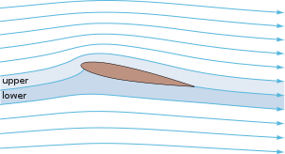
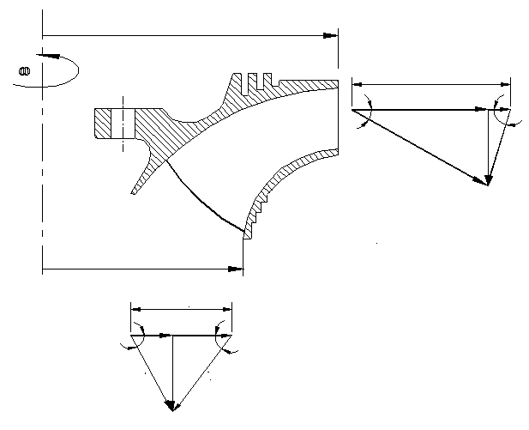
Velocity triangles
r_{ri}
U_{ri}
V_{wi}
β_{i}
α_{i}
V_{fi}
V_{ri}
V_{ai}
r_{re}
U_{re}
V_{we}
α_{e}
β_{e}
V_{fe}
V_{ae}
V_{re}

Slide 34
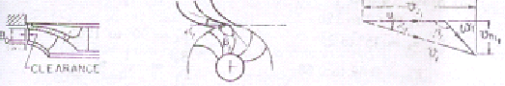
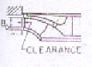
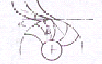
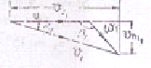
Inlet Velocity Triangles Vs Ns
Low Specific Speed : Slow Francis Runner
V_{wi}
V_{fi}
V_{ai}

Slide 35
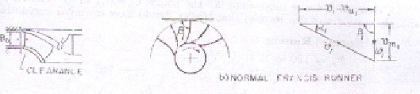
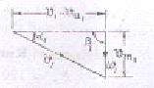
Inlet Velocity Triangles Vs Ns
Low Specific Speed : Normal Francis Runner
V_{wi}
V_{fi}
V_{ai}

Slide 36
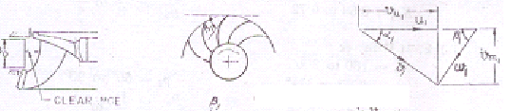
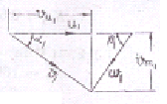
Inlet Velocity Triangles Vs Ns
High Specific Speed : Fast Francis Runner
V_{wi}
V_{fi}
V_{ai}

Slide 37
Specifications of Runner
Slow Runner: N_{s}=60 to 120
α_{ι} = 15⁰ to 25⁰
K_{ui} = 0.62 to 0.68
β_{ι} = 90⁰ to 120⁰
B₀/D_{p}=0.04 – 0.033
Normal Runner: N_{s} = 120 – 180
α_{ι} = 12⁰ to 32.5⁰
K_{ui} = 0.68 to 0.72
β_{ι} = 90⁰
B₀/D_{p}=0.125 to 0.25
Fast Runner: N_{s} = 180 to 300
α_{ι} = 32.5⁰ to 37.5⁰
K_{ui} = 0.72 to 0.76
β_{ι} = 60⁰ to 90⁰
B₀/D_{p}=0.25to 0.5

Slide 38
Selection of Exit Velocity Triangle
Exploitation of Reaction Character…..

Slide 39
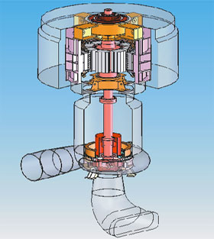
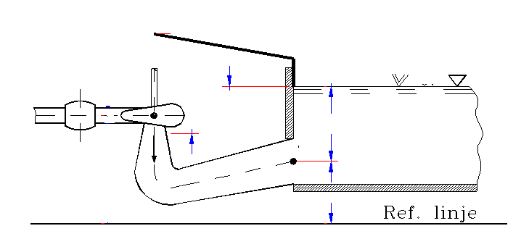
Energy of Water Leaving a Francis Runner
H_{TW}
RE
V_{are}
V_{te}
Z_{re}
TE
Z_{te}

Slide 40
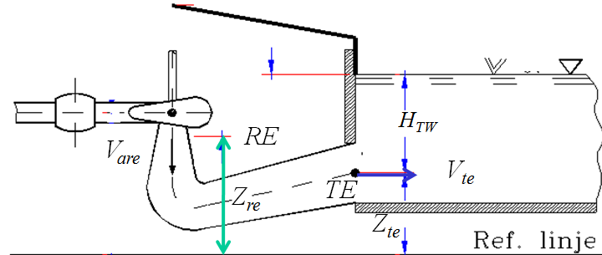
Hydraulic Energy of Exiting Fluid
For frictionless flow through exit tube
For frictional flow through exit tube
For maximum energy recovery

Slide 42
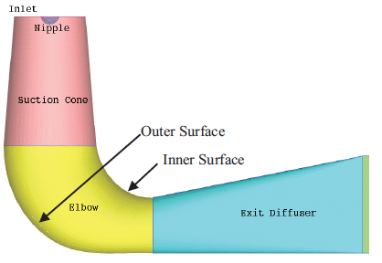
Components of Draft Tube

Slide 43
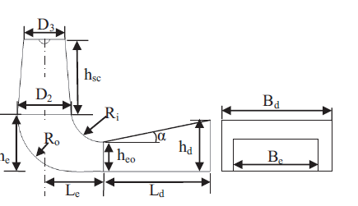
Geometric Ratios for Draft Tube

Slide 44
NPSH required

Slide 45
Dimensions of the outlet
13º < β_{e} < 22º
1,05 < a < 1,15
0,05 < b < 0,15
Highest value for highest head

Slide 46
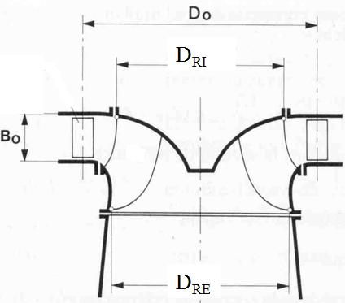
Internal Anatomy of Runner

Slide 47
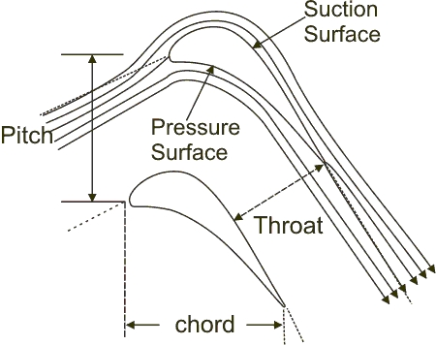
Blade Velocity Vs Tangential Component of Fluid Velocity
U_{b}
In maridional plane at mean radius of rotor
V_{w}
U_{b}
V_{r}
V_{f}
V_{a}

Slide 48
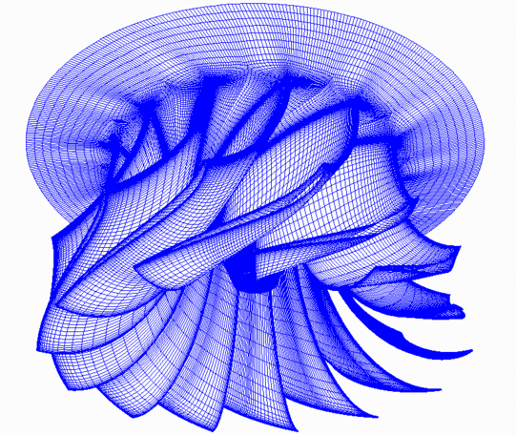
Runner Design

Slide 49
Runner Design
The main procedure in design of a new runner includes;
Use of Classical theory for shaping the blade geometry
CFD analysis for the tuning of runner geometry
The classical method;
Design the meridional plan of runner based on available methods
Obtain the perpendicular view of runner using conformal Mapping.
Modify using model testing or CFD.

Slide 50
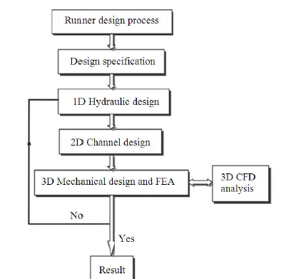
Runner Design

Slide 51
Shape of Francis Channel : Meridional Plan
R_{r1i}
R_{r1e}
R_{r2i}
L/D_{ri}
^{R}_{r2e}

Slide 52
Real values of Radii
The real value of the outlet tip radius
The real value of the intlet root radius
R_{r2e} and R_{r1i} are only fix two points of the leading and trailing edges and the rest of these curves should be drawn to lead to better efficiency of runner.

Slide 53
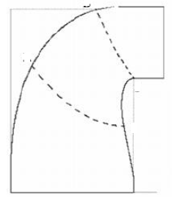
Determination of Inlet & exit edges runner
The form of these edges is two parabolic curves.
1i
Define the non-dimensional specific speed
1e
2i
For
2e
the leading edge form is a parabolic arc
with the peak in the point by radius of 2.R_{r1i}-R_{r2i}which passes through the points 1i and 2i,

